Slide 1

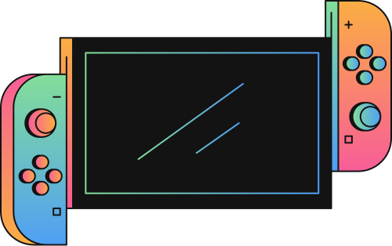
TRIVIA NIGHT
START

Slide 2


HOST
OLIVIA WILSON

Slide 3

HOW TO PLAY
A host will guide this game, which takes a 60-minute session
You will be divided into small groups
There will be themed trivia or custom questions
The host asks one question at a time, and teams write down their answers
The host calls out the correct answers and then teams tally up their points

Slide 4

INSTRUCTION
CATEGORIES
HISTORY
MOVIES
MUSIC
TECHNOLOGY

Slide 5

!
DIVIDE INTO THREE GROUPS!

Slide 6

ARE YOU READY?
PLAY

Slide 7

INSTRUCTION
TECHNOLOGY
Write a question according to the specified categories here.

Slide 8

INSTRUCTION
ANSWER
Write the correct answer to the previous question here.

Slide 9

INSTRUCTION
WINNER
TEAM 1
SCORE: 9/10

Slide 10

THANKS FOR PLAYING!
END

